Slide 1

VERSION 1.0.0 | DEC 2025
ExaminationSystem
Complete Database & Stored Procedures Documentation for Training Centers
Build by: Basel Ashraf, Abdelaziz Gamal, Yossef Ahmed Kassab, Salah Aymn, Mahmoud Eid
Environment: Microsoft SQL Server (T-SQL)

Slide 2




Critical Problems Solved
Centralized Management
Randomized Generation
Automated Correction
Safe answer submission flow with instant automated grading and precise reporting for all stakeholders.
Managed multiple branches, tracks, courses, and instructors in one relational hub, eliminating data silos.
Controlled exam creation from course-specific question banks using automated randomization algorithms.

Slide 3


System Architecture Overview
Relational Foundations
The system models complex mappings like Branch-Track M:N, Instructor-Course associations, and Course-Topic hierarchies.
Key entities include Student_Exam_Answer, which tracks granular responses, and Exam_Question, which facilitates modular exam assembly.

Slide 4
Core Schema: Physical Entities
Table | Primary Key | SQL Definition Fragment
Branch | branch_id | branch_name VARCHAR(50), branch_location VARCHAR(50)
Track | track_id | track_name VARCHAR(50), supervisor_id INT (FK)
Instructor | ins_id | ins_fname VARCHAR(50), gender CHAR(1) CHECK...
Course | course_id | course_name VARCHAR(50), hours INT CHECK (hours > 0)
Student | student_id | student_fname VARCHAR(50), student_age INT CHECK >= 18

Slide 5
Weak Entities & Junctions
Table | Composite / Primary Key | Design Logic
Question | (course_id, question_id) | Course-scoped question bank (Weak Entity)
Choice | (course_id, question_id, id) | Candidate answers with is_correct BIT
Exam_Question | (exam_id, crs_id, q_id) | Junction table for randomized exam contents
Student_Exam | (student_id, exam_id) | Tracks attempt registration and total_grade
Exam_Answer | (st_id, ex_id, crs_id, q_id) | Normalized quaternary relation for submissions

Slide 6
10 Strict Business Rules Enforced
Tracks can be offered at multiple branches via junction.
Student enrollment is required before taking exams.
One supervisor per track (enforced via unique index).
Exams must be generated via ExamGeneration SP.
Topics must map to exactly one specific Course.
Single attempt policy: duplicate attempts are blocked.
Question bank is course-scoped with composite PKs.
Correctness computed as an integer percentage.
MCQs require exactly one Choice.is_correct = 1.
Referential integrity: 3NF normalization maintained.

Slide 7
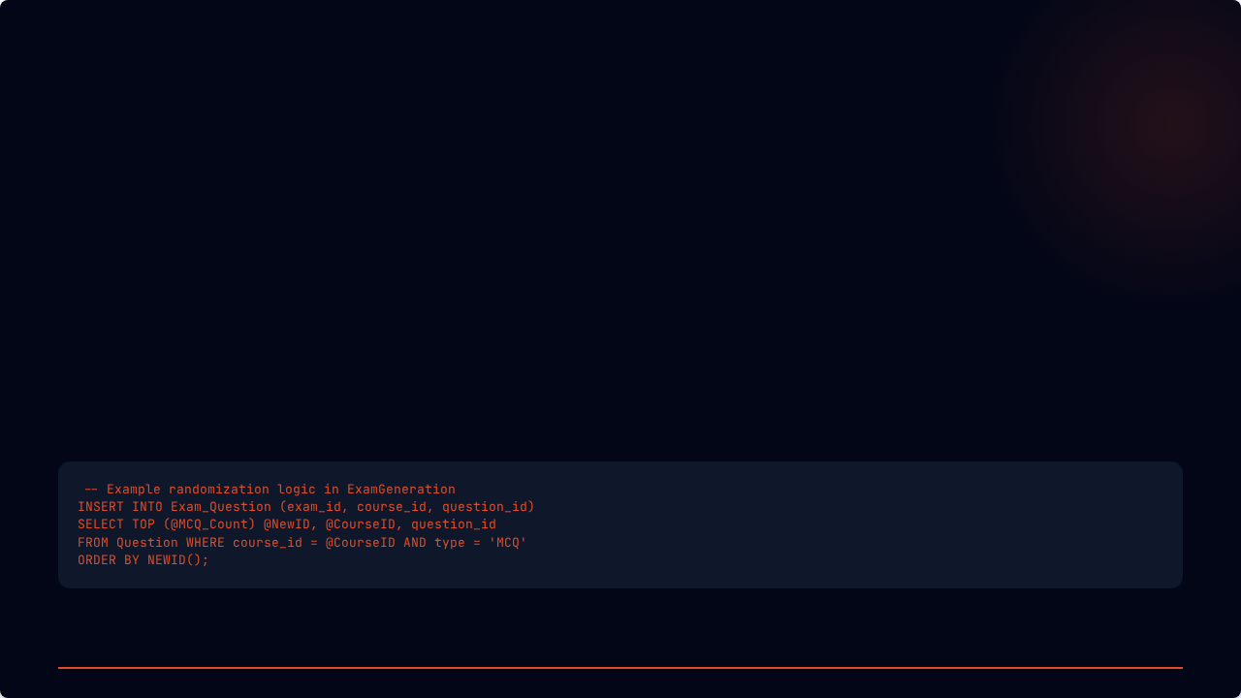


Core Logic: Stored Procedures
ExamGeneration
ExamAnswer
ExamCorrection
Randomly selects N MCQ and M TF questions using ORDER BY NEWID() and TABLOCKX for safety.
Parses CSV answers, validates student eligibility, and prevents re-submissions within an explicit transaction.
Uses TRY_CAST to map student answers to choice_id and computes final grades automatically.

Slide 8
Built-in Analytics & Reporting
Procedure Name | Key Output Columns | Purpose
Course_Topics | course_name, topic_name | Syllabus overview for students
Exam_Questions | description, choice_text, is_correct | Reviewing specific exam contents
Instructor_Courses | course_id, student_count | Tracking instructor teaching load
Student_grade | Full_Name, course_name, grade | Official transcript generation
Exam_Model_Answer | description, student_ans, correct_ans | Student feedback and review

Slide 9





Enterprise Security Framework
Transaction Safety
RBAC Implementation
Trigger Logic
Uses SET XACT_ABORT ON and explicit rolls backs to ensure atomic operations during exam grading.
Roles: db_admin (Global), db_instructor (Course/Exam), db_student (Read-only results).
4 Critical triggers: Course matching, supervisor verification, registration validation, and answer safety.

Slide 10

Performance & Scaling Architecture
Optimized Indices
Recommendation: Replace MAX(id)+1 with SEQUENCE objects for high-concurrency environments.

Slide 11
Lifecycle of an Examination
2. Enroll
4. Register
6. Grade
Student Enrollment
Student to Exam
Auto Correction SP
1. Setup
3. Generate
5. Submit
7. Report
Create Course & Q-Bank
Randomized Exam SP
ExamAnswer SP
Final Performance View

Slide 12





PRODUCTION-READY RDBMS
Built By the Team
Connect with us on LinkedIn for Database Architecture & T-SQL Development
ExaminationSystem v1.0.0 | Enterprise Database Solutions

